Slide 1

David M. Kroenke and David J. Auer Database Processing Fundamentals, Design, and Implementation
Chapter Six:
Transforming Data Models
into
Database Designs

Slide 2
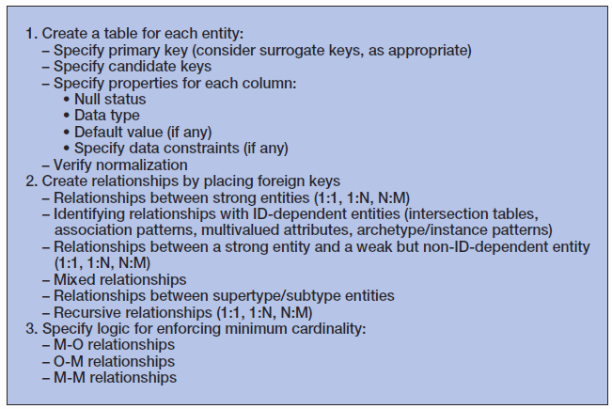
Steps for Transforming a Data Model into a Database Design

Slide 3
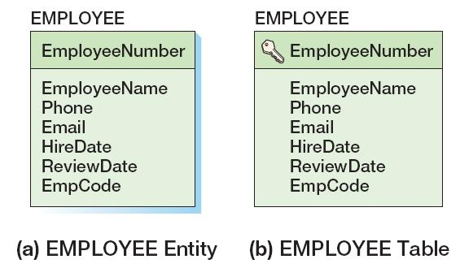
Create a Table for Each Entity
EMPLOYEE (EmployeeNumber, EmployeeName, Phone, Email, HireDate, ReviewDate, EmpCode)
Primary key is designated by the key symbol
Note shadowless table

Slide 4
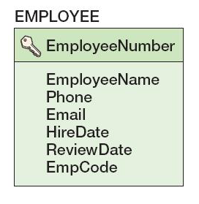
Select the Primary Key
The ideal primary key is short, numeric, and fixed.
Surrogate keys meet the ideal, but have no meaning to users.

Slide 5
Specify Candidate (Alternate) Keys
The terms candidate key and alternate key are synonymous.
Candidate keys are alternate identifiers of unique rows in a table.
Will use AKn.m notation, where n is the number of the alternate key, and m is the column number in that alternate key.

Slide 6
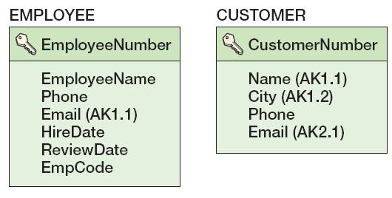
Specify Candidate (Alternate) Keys

Slide 7
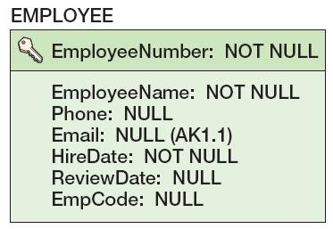
Specify Column Properties: Null Status
Null status indicates whether or not the value of the column can be NULL.

Slide 8
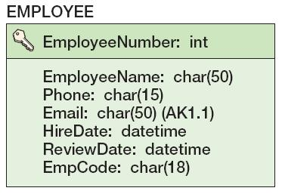
Specify Column Properties: Data Type
Generic data types:
CHAR(n)
VARCHAR(n)
DATE
TIME
MONEY
INTEGER
DECIMAL

Slide 9
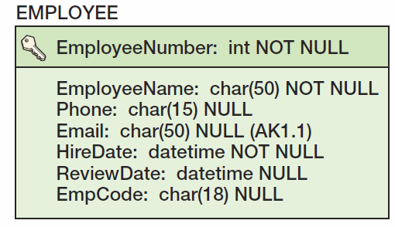
Specify Column Properties: Data Type + Null Status

Slide 10
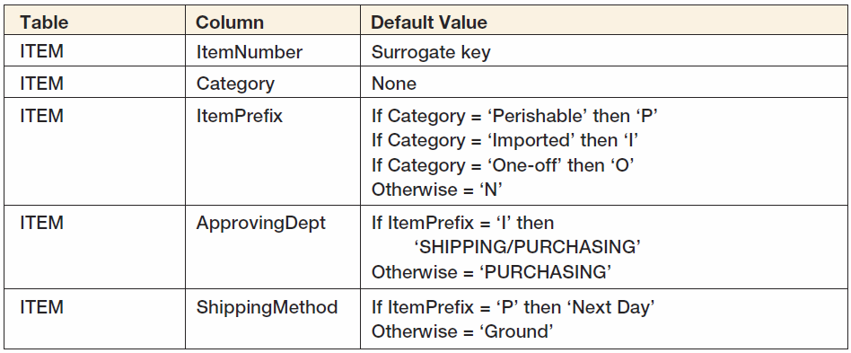
Specify Column Properties: Default Value
A default value is the value supplied by the DBMS when a new row is created.

Slide 11
Specify Column Properties: Data Constraints
Data constraints are limitations on data values:
Domain constraint—column values must be in a given set of specific values.
Range constraint—column values must be within a given range of values.
Intrarelation constraint—column values are limited by comparison to values in other columns in the same table.
Interrelation constraint—column values are limited by comparison to values in other columns in other tables (referential integrity constraints on foreign keys).

Slide 12
Verify Normalization
The tables should be normalized based on the data model.
Verify that all tables are:
BCNF
4NF

Slide 13
Create Relationships: 1:1 Strong Entity Relationships
Place the key of one entity in the other entity as a foreign key.
Either design will work—no parent, no child
Minimum cardinality considerations may be important.
O-M will require a different design than M-O.
One design will be very preferable.

Slide 14
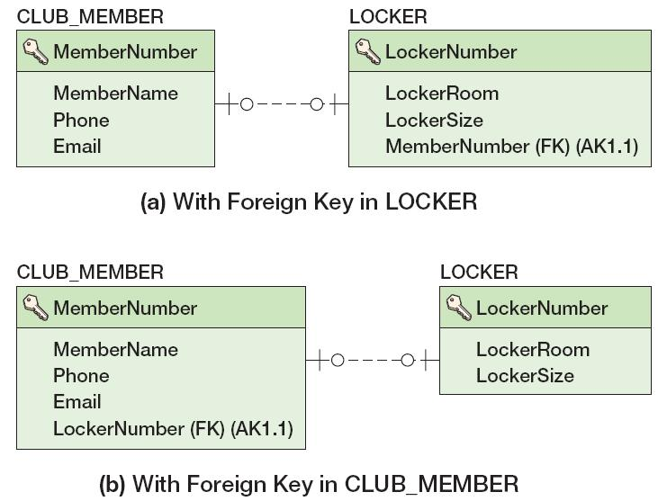
Create Relationships: 1:1 Strong Entity Relationships

Slide 15
Create Relationships: 1:N Strong Entity Relationships
Place the primary key of the table on the one side of the relationship into the table on the many side of the relationship as the foreign key.
The one side is the parent table and the many side is the child table, so “place the key of the parent in the child.”

Slide 16
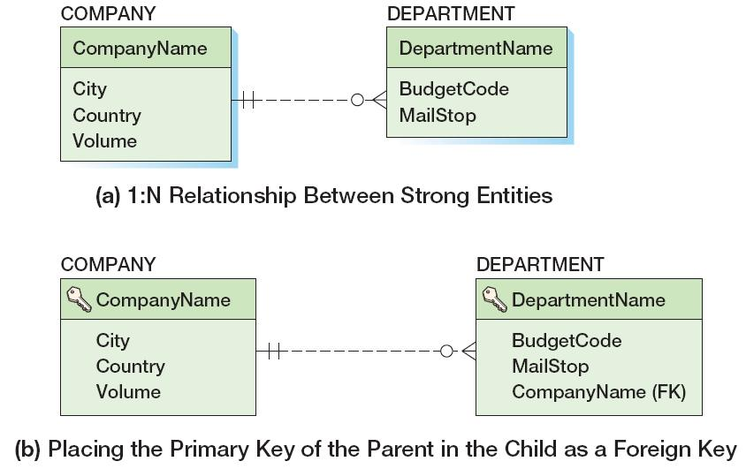
Create Relationships: 1:N Strong Entity Relationships

Slide 17
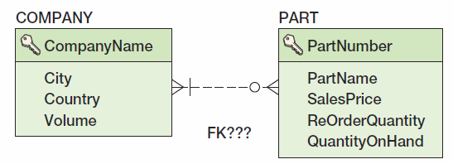
Create Relationships: N:M Strong Entity Relationships
In an N:M strong entity relationship there is no place for the foreign key in either table.
A COMPANY may supply many PARTs.
A PART may be supplied by many COMPANYs.

Slide 18
Create Relationships: N:M Strong Entity Relationships
The solution is to create an intersection table that stores data about the corresponding rows from each entity.
The intersection table consists only of the primary keys of each table which form a composite primary key.
Each table’s primary key becomes a foreign key linking back to that table.
COMPANY_PART_INT (CompanyName, PartNumber)

Slide 19
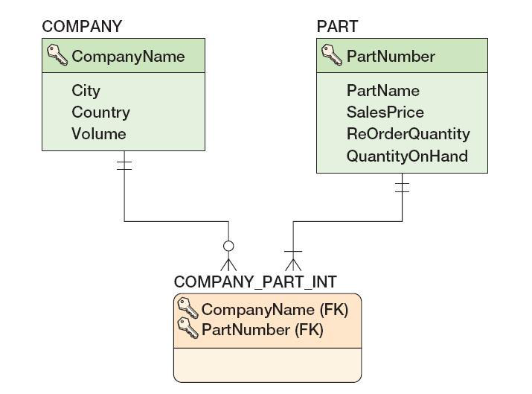
Create Relationships: N:M Strong Entity Relationships
COMPANY_PART_INT (CompanyName, PartNumber)

Slide 20
Relationships Using ID-Dependent Entities: Four Uses for ID-Dependent Entities
Representing N:M Relationships
We just discussed this
Association Relationships
Multivalued Attributes
Archetype/Instance Relationships

Slide 21
Relationships Using ID-Dependent Entities: Association Relationships
An intersection table
Holds the relationships between two strong entities in an N:M relationship
Contains only the primary keys of the two entities:
As a composite primary key
As foreign keys
An association table
Has all the characteristics of an intersection table
PLUS it has one or more columns of attributes specific to the associations of the other two entities

Slide 22
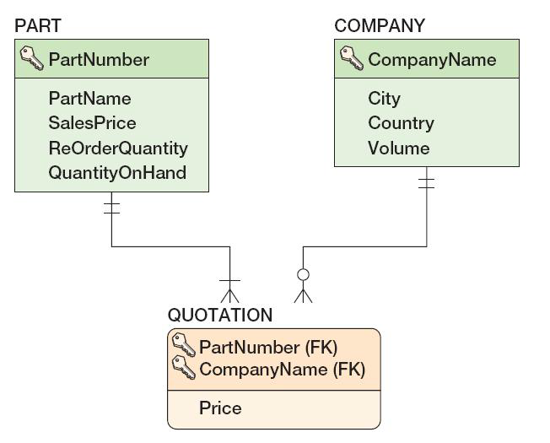
Relationships Using ID-Dependent Entities: Association Relationships
QUOTATION (CompanyName, PartNumber, Price)

Slide 23
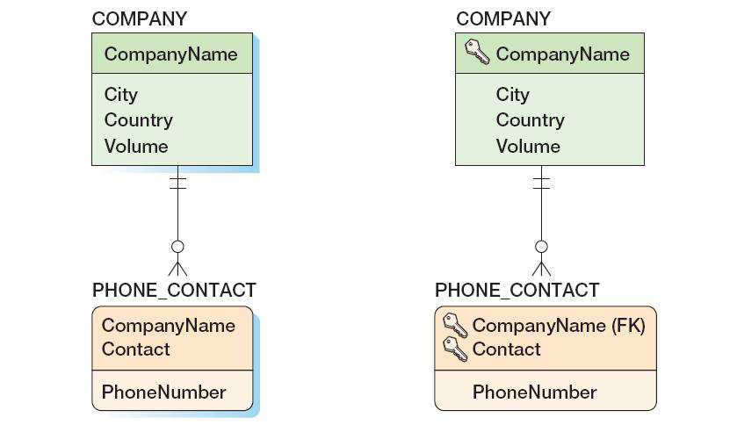
Relationships Using ID-Dependent Entities: Multivalued Attributes
As a data model
As a database design

Slide 24
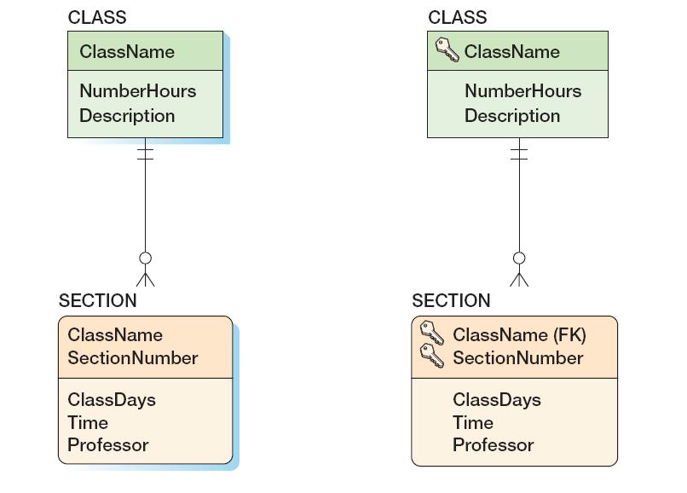
Relationships Using ID-Dependent Entities: Archetype/Instance Pattern
As a data model
As a database design

Slide 25
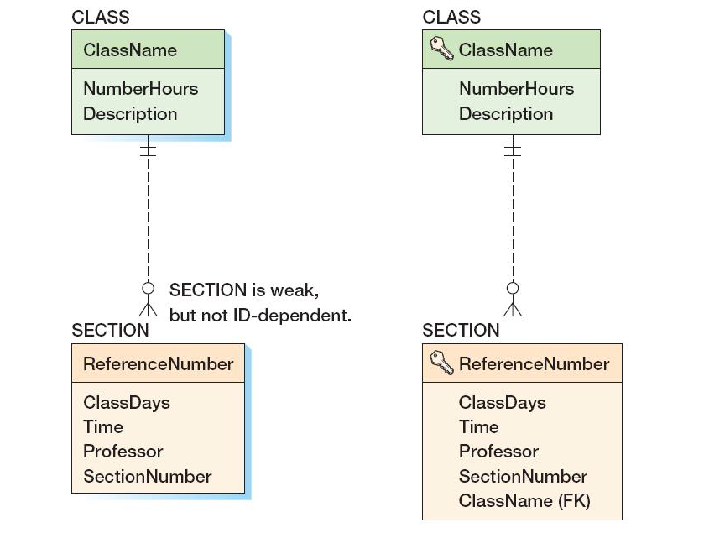
Relationships Using Weak Entities: Archetype/Instance Pattern
As a data model
As a database design

Slide 26
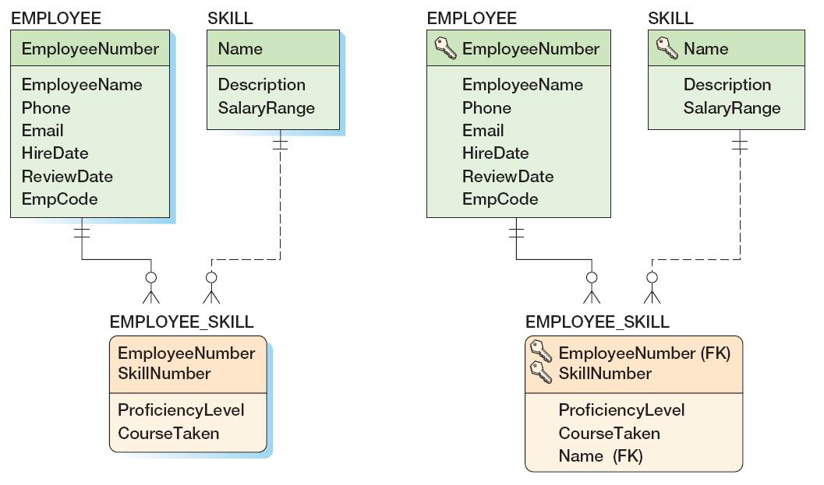
Mixed Entity Relationships
As a data model
As a database design

Slide 27
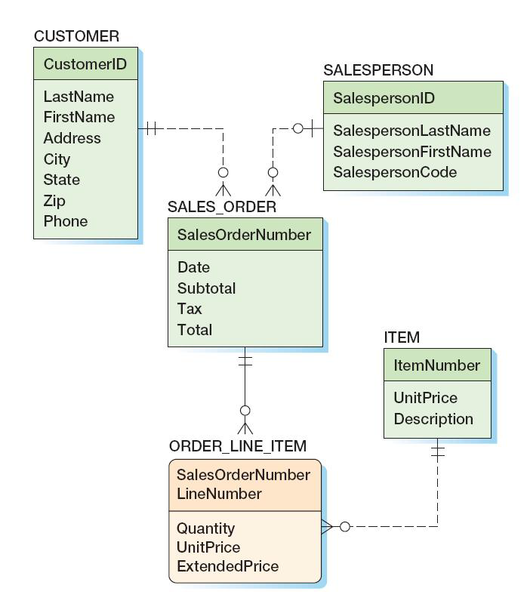
Mixed Entity Relationships: The SALES_ORDER Pattern
As a data model

Slide 28
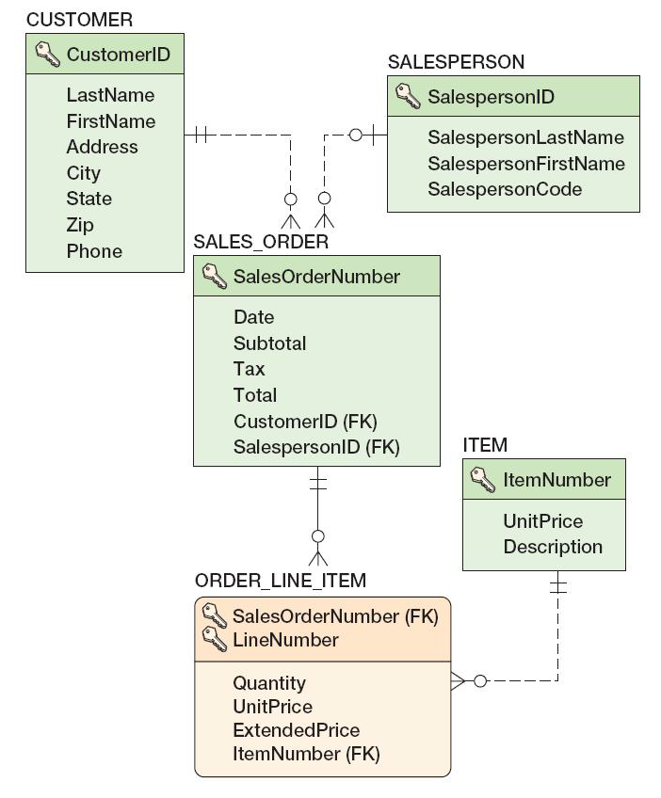
Mixed Entity Relationships: The SALES_ORDER Pattern
As a database design

Slide 29
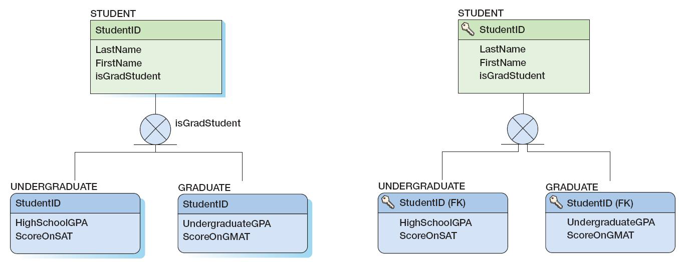
Subtype Relationships
As a data model
As a database design

Slide 30
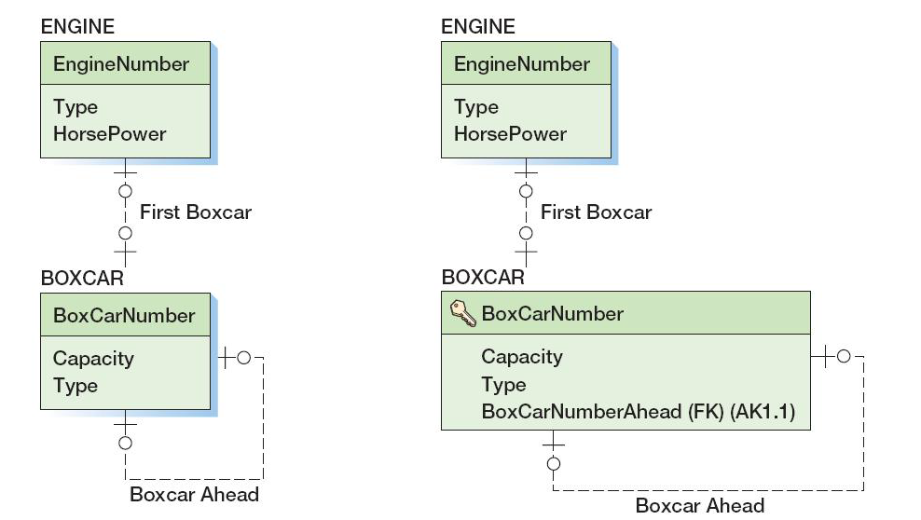
Recursive Relationships: 1:1 Recursive Relationships
As a data model
As a database design

Slide 31
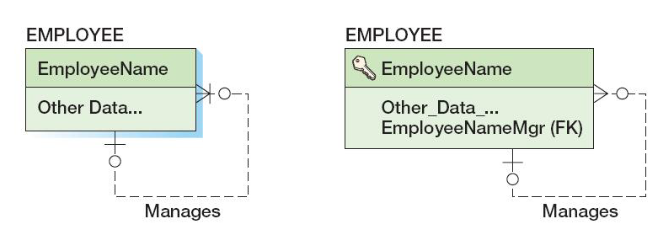
Recursive Relationships: 1:N Recursive Relationships
As a data model
As a database design

Slide 32
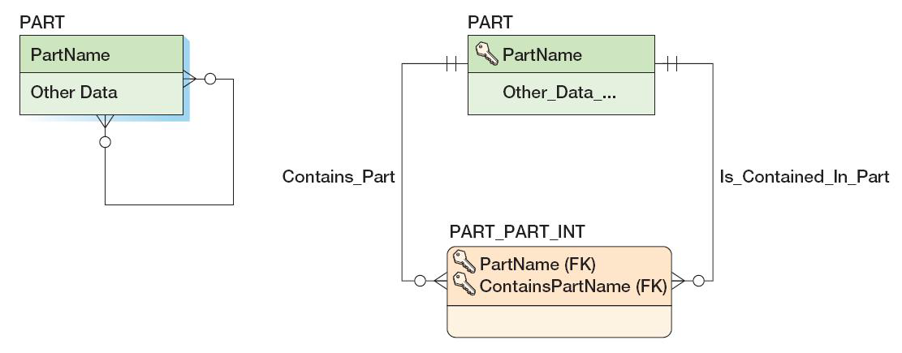
Recursive Relationships: N:M Recursive Relationships
As a data model
As a database design

Slide 33
Representing Ternary and Higher-Order Relationships
Ternary and higher-order relationships may be constrained by the binary relationship that comprise them.
MUST constraint—requires that one entity must be combined with another entity in the ternary (or higher-order) relationship.
MUST NOT constraint—requires that certain combinations of two entities are not allowed to occur in the ternary (or higher-order) relationship.
MUST COVER constraint—a binary relationship specifies all combinations of two entities that must appear in the ternary (or higher-order) relationship.

Slide 34
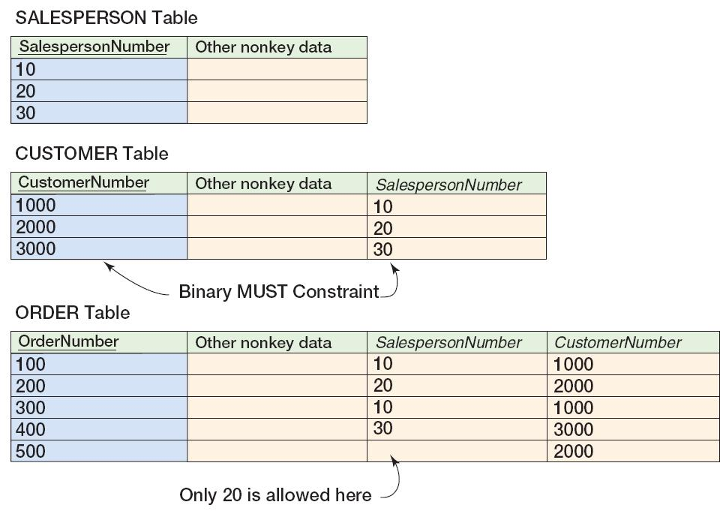
MUST Constraint

Slide 35
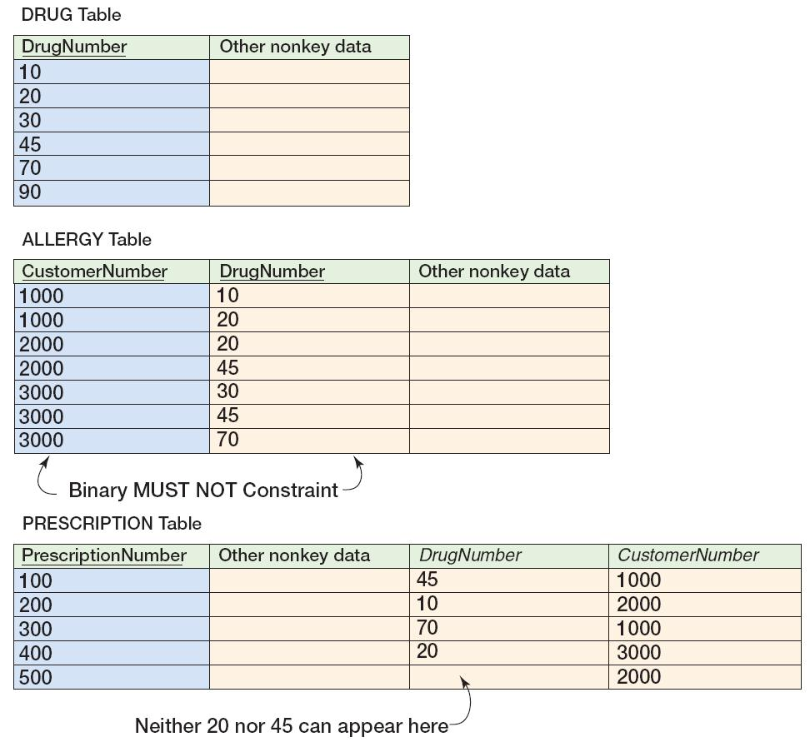
MUST NOT Constraint

Slide 36
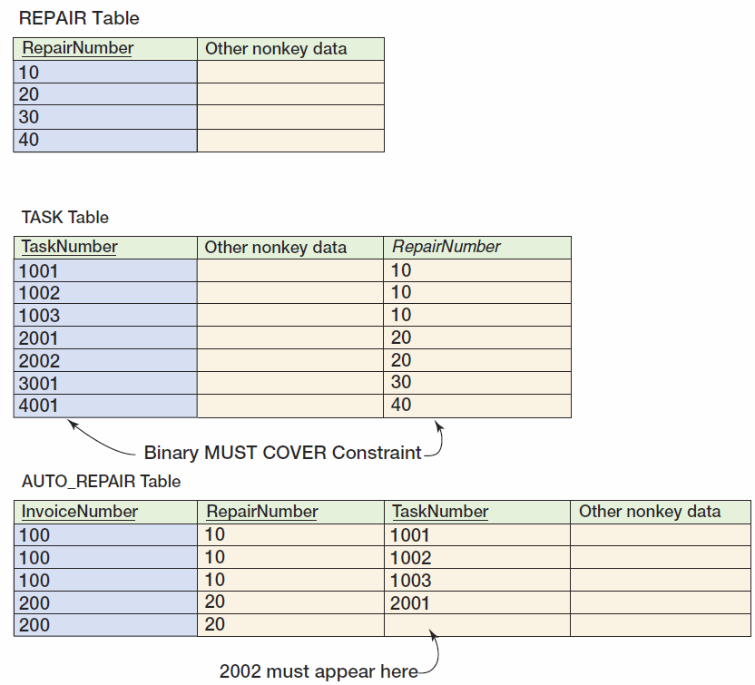
MUST COVER Constraint

Slide 37
Design for Minimum Cardinality
Relationships can have the following types of minimum cardinality:
O-O: parent optional and child optional
M-O: parent mandatory and child optional
O-M: parent optional and child mandatory
M-M: parent mandatory and child mandatory
We will use the term action to mean a minimum cardinality enforcement action.
No action needs to be taken for O-O relationships.

Slide 38
Cascading Updates and Deletes
A cascading update occurs when a change to the parent’s primary key is applied to the child’s foreign key.
Surrogate keys never change and there is no need for cascading updates when using them.
A cascading delete occurs when associated child rows are deleted along with the deletion of a parent row.
For strong entities, generally do not cascade deletes
For weak entities, generally do cascade deletes

Slide 39
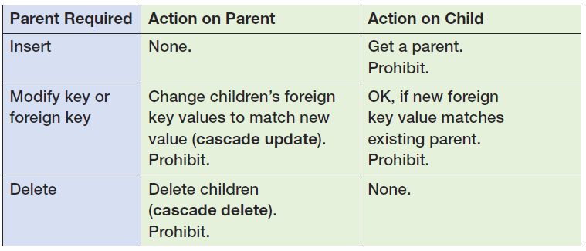
Actions When the Parent Is Required [Figure 6-28(a)]

Slide 40
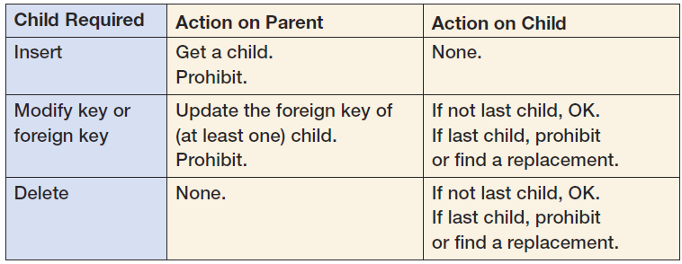
Actions When the Child Is Required [Figure 6-28(b)]

Slide 41
Application Programming: Triggers
Application programming uses SQL embedded in triggers, stored procedures, and other program code to accomplish a specific task.
A trigger is a stored program that is executed by the DBMS whenever a specified event occurs on a specified table or view (defined in Chapter Seven).
Triggers are used to enforce specific minimum cardinality enforcement actions not otherwise programmed into the DBMS.
Triggers will be discussed in detail in Chapters 7, 10 (SQL Server), 10A (Oracle Database),and 10B (MySQL 5.5).

Slide 42
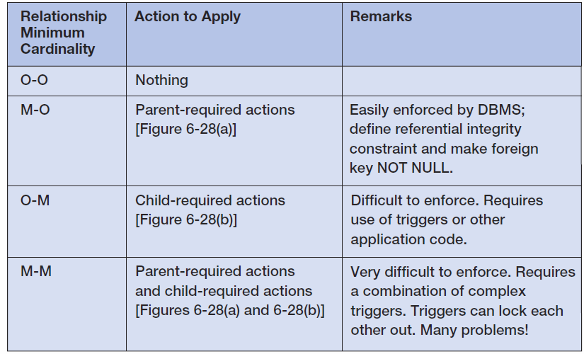
Actions To Apply to Enforce Minimum Cardinality

Slide 43
Implementing Actions for M-O Relationships
Make sure that:
Every child has a parent.
Operations never create orphans.
The DBMS will enforce the action as long as:
Referential integrity constraints are properly defined.
The foreign key column is NOT NULL.

Slide 44
Implementing Actions for O-M Relationships
The DBMS does not provide much help.
Triggers or other application codes will need to be written.

Slide 45
Implementing Actions for M-M Relationships
The worst of all possible worlds:
Especially in strong entity relationships.
In relationships between strong and weak entities the problem is often easier when all transactions are initiated from the strong entity side.
Complicated and careful application programming will be needed.

Slide 46
Implementing Actions for M-O Relationships: DEPARTMENT and EMPLOYEE
DEPARMENT is parent—EMPLOYEE is child.
Actions on parent:
DEPARTMENT rows can be created.
DEPARTMENT primary key—cascade updates if not surrogate key.
IF a DEPARTMENT is deleted, do we delete the associate EMPLOYEEs?
IF YES—cascade deletes.
IF NO—prohibit associate employees.

Slide 47
Implementing Actions for M-O Relationships: DEPARTMENT and EMPLOYEE
Actions on child
Set referential integrity constraint and set foreign key to NOT NULL.
A new EMPLOYEE must have a valid DEPARTMENT or disallow the insert.
EMPLOYEEs can be reassigned to a different DEPARTMENT if a valid DEPARTMENT or disallow the update.
EMPLOYEEs can be deleted.

Slide 48
Implementing Actions for O-M Relationships: DEPARTMENT and EMPLOYEE
DEPARTMENT is parent—EMPLOYEE is child.
There must be at least one child row for each parent at all times.
Actions on parent:
DEPARTMENT rows can only be created when a relationship is created to a child row—REQUIRES A TRIGGER.
DEPARTMENT primary keys can only be updated if at least one EMPLOYEE foreign key is also updated —REQUIRES A TRIGGER.
Can a DEPARTMENT be deleted?
YES—it is the EMPLOYEE who is required.

Slide 49
Implementing Actions for O-M Relationships: DEPARTMENT and EMPLOYEE
Actions on child
OK to insert a new EMPLOYEE.
There must be one EMPLOYEE for each department.
Cannot change EMPLOYEE foreign key (DEPARTMENT) if last EMPLOYEE in the DEPARTMENT.
Cannot delete an EMPLOYEE if last EMPLOYEE in the DEPARTMENT.

Slide 50
Implementing Actions for M-M Relationships: DEPARTMENT and EMPLOYEE
DEPARMENT is parent—EMPLOYEE is child.
All of the previous (M-O and O-M) apply at the same time!
This creates conflicts that require careful programming to avoid or fix problems such as:
A new DEPARTMENT insert will run a trigger that tries to create a new EMPLOYEE, but the EMPLOYEE row is checked by the DBMS for a valid DEPARTMENT before the transaction is completed.
If we try to delete a DEPARTMENT with any EMPLOYEEs we will find the trigger on EMPLOYEE delete will not let us delete the last EMPLOYEE, so we can’t delete the DEPARMENT.

Slide 51
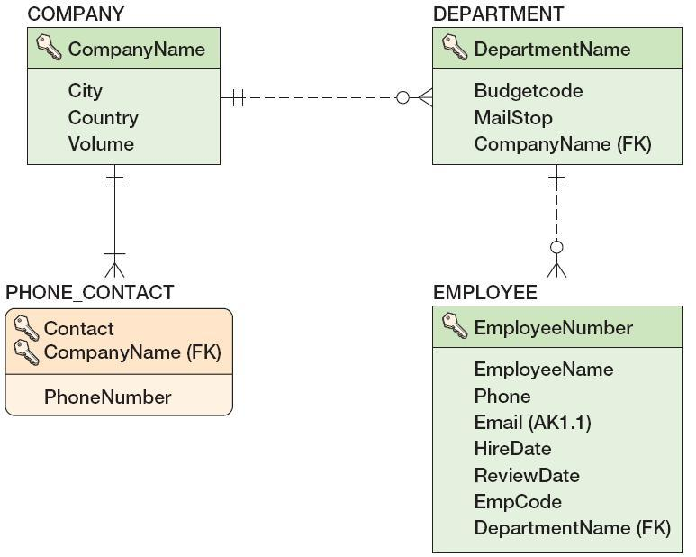
Documenting the Minimum Cardinality Design: Documenting Required Parents
COMPANY is parent, DEPARTMENT is child.
The relationship is M-O.
This can often be done in the database design tools.

Slide 52
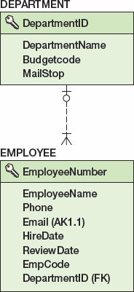
Documenting the Minimum Cardinality Design: Documenting Required Children
DEPARTMENT is parent, EMPLOYEE is child.
The relationship is O-M.
Use documentation based on Figure 6-28(b)—see the next slide.

Slide 53
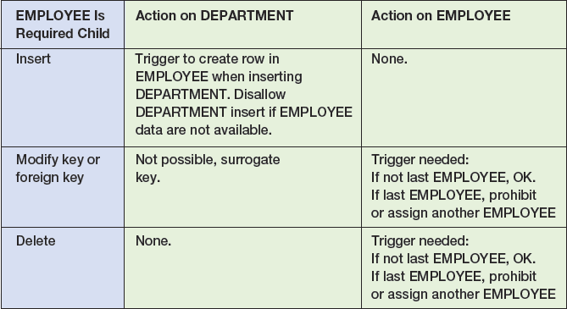
Documenting the Minimum Cardinality Design: Documenting Required Children

